Slide 1
Symbolic AI 2.0
Yi Zhou

Slide 2
  Content
    AI – a brief introduction
    Connectionism, Behaviourism, Symbolism
    Where are we?
    Symbolic AI 2.0
    Concluding remarks

Slide 3
  Content
    AI – a brief introduction
    Connectionism, Behaviourism, Symbolism
    Where are we?
    Symbolic AI 2.0
    Concluding remarks

Slide 4
AI - Inspirations
logic
psychology
social science
cognitive science
neuro- science
statistics
reflex
economics
philosophy
of mind

Slide 5
AI - Approaches
logic programming
expert system
default logic
propositional logic
ontology
SVM
first-order logic
answer set
Bayesian network
SOAR
neural network
situation calculus
reactive rule
GPS
decision theory
planning
game theory
NLP
CSP
MDP
……………….

Slide 6

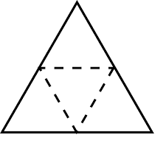
AI: 3 Essential Tasks
AI
AI
representation
representation
knowledge
learning
reasoning
reasoning
learning

Slide 7
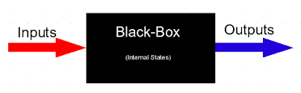
AI: 3 Essential Tasks
    knowledge representation
        How to model inputs, outputs and internal states?
    knowledge reasoning
        How to derive outputs from inputs through internal states?
    knowledge learning
        How to engineer the internal states (by given
        correct samples of input-output pairs)?

Slide 8
  Content
    AI – a brief introduction
    Connectionism, Behaviourism, Symbolism
    Where are we?
    Symbolic AI 2.0
    Concluding remarks

Slide 9
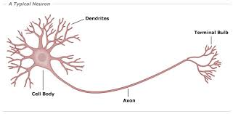
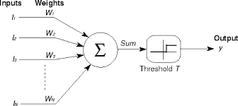
Connectionism – Inspiration

Slide 10
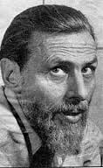
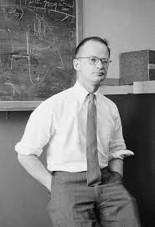
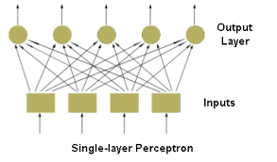
Connectionism – Origin

Slide 11




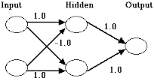
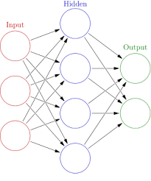
Connectionism – 1st Winter

Slide 12




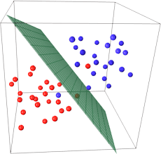
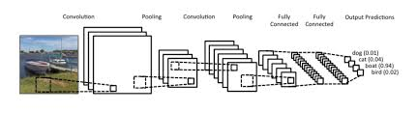
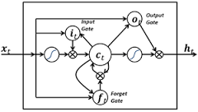
Connectionism – 2nd Winter

Slide 13
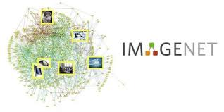



Connectionism – Applications

Slide 14
Connectionism – RRL
    knowledge representation
        How to model inputs, outputs and internal states?
        (deep) (convolutional, recurrent) neural network
    knowledge reasoning
        How to derive outputs from inputs through internal states?
        forward propagation
    knowledge learning
        How to engineer the internal states (by given correct samples of input-output pairs)?
        backward propagation

Slide 15
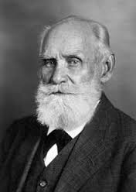
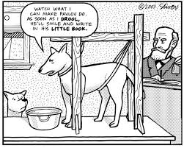
Behaviourism – Inspiration

Slide 16
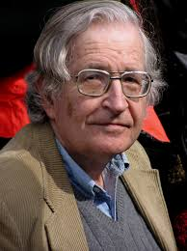
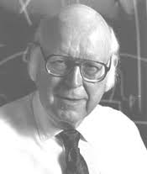
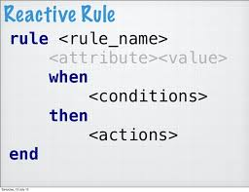
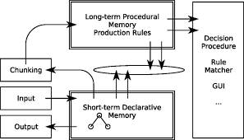
Behaviourism – Early Approaches

Slide 17

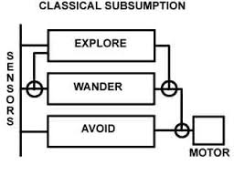
Behaviourism – 1st Spring

Slide 18


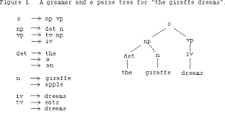
Behaviourism – Applications

Slide 19
Behaviourism – RRL
    knowledge representation
        How to model inputs, outputs and internal states?
        (multi-layer) reactive rules
    knowledge reasoning
        How to derive outputs from inputs through internal states?
        reaction
    knowledge learning
        How to engineer the internal states (by given correct samples of input-output pairs)?
        hand-coded

Slide 20
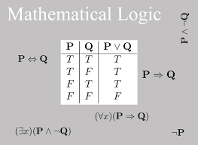
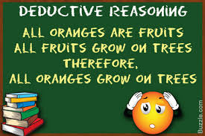
Symbolism 1.0 – Inspiration

Slide 21

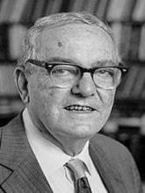
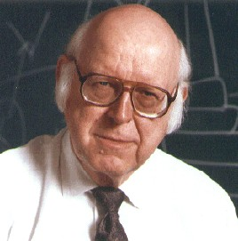



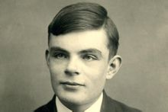
Symbolism – “Turing” Award

Slide 22

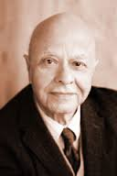





Symbolism – IJCAI Award for Research Excellence

Slide 23
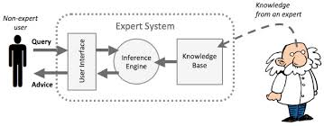
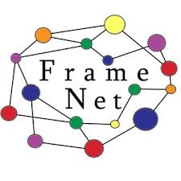

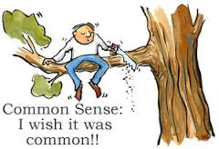

Symbolism 1.0 – 1st Winter
ConceptNet5

Slide 24





Symbolism 1.5 – 1st Spring
Using machine learning to mine knowledge from dark data
Automated Knowledge
Base Construction
Automated Knowledge
Base Completion
Semantic Parsing

Slide 25

Symbolism 1.5 – Applications

Slide 26
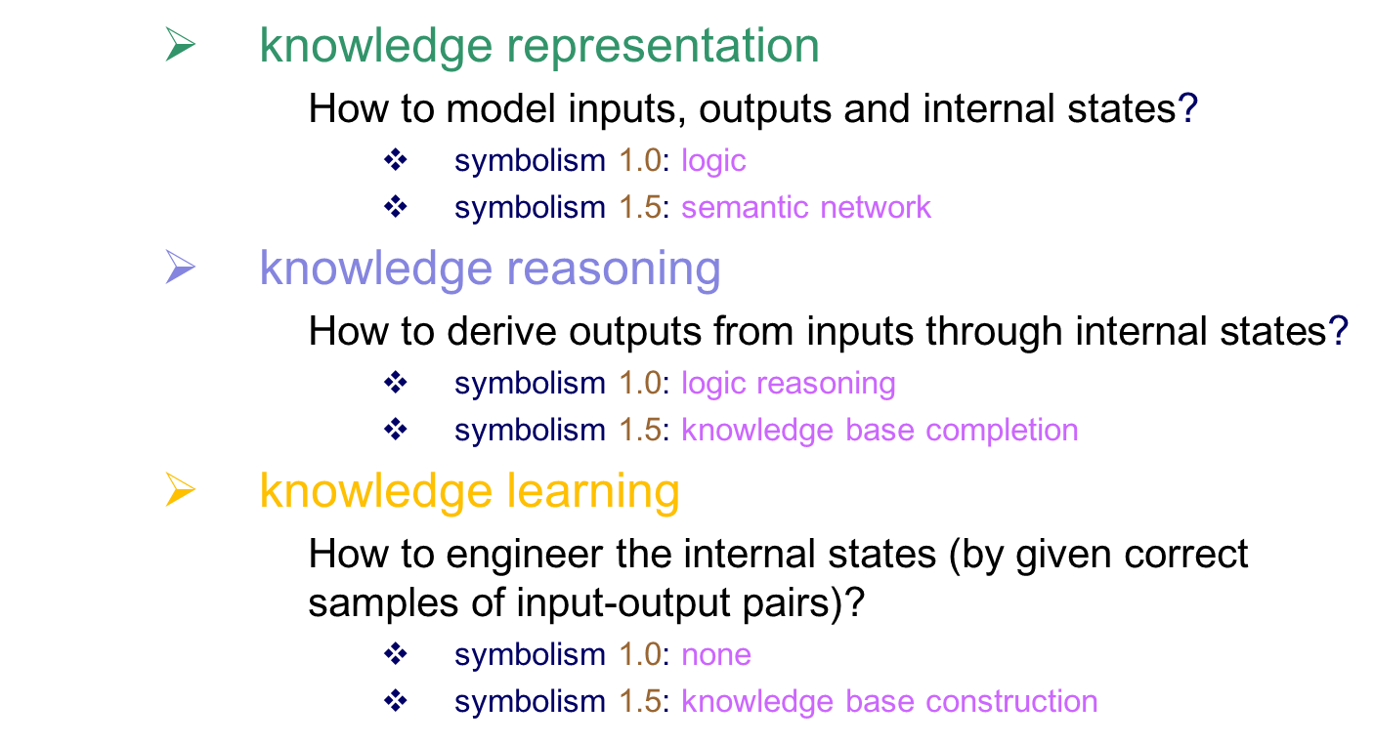
Symbolism – RRL

Slide 27
  Content
    AI – a brief introduction
    Connectionism, Behaviourism, Symbolism
    Where are we?
    Symbolic AI 2.0
    Concluding remarks

Slide 28

Measuring AI
representation
AI
reasoning
learning

Slide 29
Measuring AI - Connectionism
    knowledge representation
        Pres: all functions in principle
        Cons: case by case in practice
        Overall: 2
    knowledge reasoning
        Pres: simulation/approximation
        Cons: deduction/logical reasoning
        Overall: 2
    knowledge learning
        Pres: learning parameters
        Cons: learning knowledge
        Overall: 4
representation
AI
reasoning
learning

Slide 30
Measuring AI - Behaviourism
    knowledge representation
        Pres: low level
        Cons: high level
        Overall: 2
    knowledge reasoning
        Pres: efficient
        Cons: not expressive
        Overall: 4
    knowledge learning
        Pres:
        Cons: limited learning
        Overall: 1
representation
AI
reasoning
learning

Slide 31
Measuring AI – Symbolism 1.0
    knowledge representation
        Pres: logic symbols
        Cons: extensibility
        Overall: 4
    knowledge reasoning
        Pres: sound, complete
        Cons: slow
        Overall: 2
    knowledge learning
        Pres:
        Cons: limited learning
        Overall: 1
representation
AI
reasoning
learning

Slide 32
Measuring AI – Symbolism 1.5
    knowledge representation
        Pres: triplet
        Cons: extensibility, complicated form
        Overall: 3
    knowledge reasoning
        Pres: query
        Cons: deduction, explanation
        Overall: 2
    knowledge learning
        Pres: simple knowledge
        Cons: complicated knowledge
        Overall: 3
representation
AI
reasoning
learning

Slide 33
What We Want
representation
AI
reasoning
learning
    from data science to knowledge science
        knowledge representation
        knowledge reasoning
        knowledge learning

Slide 34
  Content
    AI – a brief introduction
    Connectionism, Behaviourism, Symbolism
    Where are we?
    Symbolic AI 2.0
    Concluding remarks

Slide 35
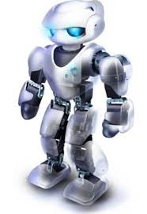

Representation
Plan
Relation
Time/Space
Algorithm
Preference
Action
Probability
Type
Proposition
Utility
Modality
Arithmetic
Fuzzy
Quantifier
Rule
Muliagents
Problem: one more building block, much more effort
Challenge: how to make them living happily ever after

Slide 36

Reasoning
Expressiveness
Efficiency
Problem: more expressive less efficient, more efficient less expressive
Challenge: both are needed but there is no free lunch

Slide 37
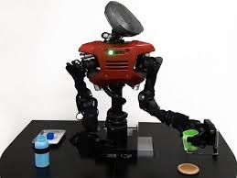
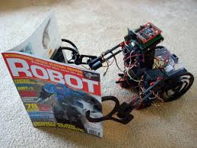
Learning
Problem: KR reasoners are algorithm based, little power to learn
Challenge: learnable reasoning

Slide 38
6E: What we need
Elegant
Extensible
Expressive
Efficient
Educable
Evolvable
representation
AI
reasoning
learning

Slide 39
Representation
Plan
Relation
Time/Space
Algorithm
Preference
Action
Probability
Type
Proposition
Utility
Modality
Arithmetic
Fuzzy
Quantifier
Rule
Muliagents
Problem: one more building block, much more effort
Challenge: how to make them living happily ever after
Solution: extensible KR – assertional logic

Slide 40
Reasoning
Expressiveness
Efficiency
Problem: more expressive less efficient, more efficient less expressive
Challenge: both are needed but there is no free lunch
Solution: reasoning by knowledge
Efficient

Slide 41
Learning
Problem: KR reasoners are algorithm based, little power to learn
Challenge: learnable reasoning
Solution: learnable knowledge
Educable
Evolvable

Slide 42



To Do
+
+
representation
learning
reasoning

Slide 43
  Content
    AI – a brief introduction
    Connectionism, Behaviourism, Symbolism
    Where are we?
    Symbolic AI 2.0
    Potential applications
    Concluding remarks

Slide 44
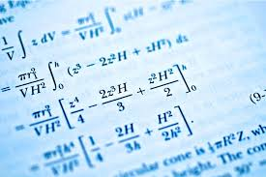
Mathematics test
Notes:
intelligence test.
IQ test
university entry level mathematics test

Slide 45
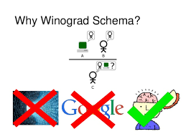

Post Turing Test
The box does not fit well into the suitcase because it is too small/big.
What doe “it” refers to?
(A) the box
(B) the suitcase
Radom guess: 50%
Stanford CoreNLP: 51%
State-of-the-art: 57%

Slide 46



Intelligence Test

Slide 47

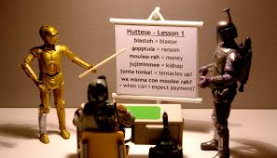
Knowledge-Based
Natural Language Understanding

Slide 48

RPA & Enterprise Knowledge Base

Slide 49



Knowledge Based Search
万亿美元市场
？？？？？

Slide 50
And Many More ……
    Knowledge based recommendation system
    Knowledge enhanced QA system
    Fintech
    AI in X (education, law, medicine, ……)
    ……

Slide 51
  Content
    AI – a brief introduction
    Connectionism, Behaviourism, Symbolism
    Where are we?
    Symbolic AI 2.0
    Concluding remarks

Slide 52
Concluding Remarks
    AI = representation + reasoning + learning (knowledge)
    AI: connectionism, behaviourism, symbolism
    All experienced winter and spring
    so far so good, but a long way to go
    symbolic AI 2.0: the 6 E’s
    symbolic AI 2.0: the next generation

Slide 53

Thank you!

